Slide 1


Green Pace
Security Policy Presentation
Developer: Kris Marchevka

Slide 2

OVERVIEW: DEFENSE IN DEPTH
Policy was created to ensure consistent implementation of secure coding principles.
Keeps Green Pace’s practices standardized as well as supports defense-in-depth. (Multiple protective layers at code, architecture, and process levels.

Slide 3
THREATS MATRIX
Likely - STD-002 Numeric Input Validation: Unvalidated frequently occur in real systems; without checks this can lead to overflows and divide-by-zero. - STD-010 Format String Injection: User-controlled format strings are a common exploit path. | Priority - STD-004 SQL Injection: Critical because it can expose databases directly. - STD-002 / STD-010: Overlap here due to severity of potential exploits.
Low priority - STD-006 Assertion Side Effects: Rarely leads to compromise but can destabilize releases. - STD-007 Catch by Value: Performance and stability issue rather than direct exploit. - STD-008 Static Objects Not Const: Misuse risk is low but still violates best practices. | Unlikely - STD-001 Fixed-Width Integers: Overflow possible, but less likely with careful coding. - STD-003 String Bounds: Preventable with safe APIs, though still dangerous if ignored. - STD- 005 Use-After-Free: Less likely with RAII patterns and modern coding practices. - STD-009 Locking Deadlocks: Rare but severe when they occur. Careful design reduces likelihood.

Slide 4
10 PRINCIPLES
Validate Input Data – STD-001, STD-002, STD-003, STD-010
Heed Compiler Warnings – STD-006
Architect & Design for Security – STD-008, STD-009
Keep It Simple – STD-003, STD-005, STD-007
Default Deny – STD-002, STD-004, STD-008
Least Privilege – STD-004
Sanitize Data Sent to Other Systems – STD-004, STD-010
Practice Defense in Depth – STD-009
Use Effective Quality Assurance Techniques – STD-005, STD-006, STD-009
Adopt a Secure Coding Standard – Applies to all standards.

Slide 5
CODING STANDARDS
STD-004 – Parameterized Queries (SQL Injection
- Critical impact, prevents direct database compromise.
STD-002 – Numeric Input Range Validation
Common exploit path (divide by zero, overflows).
STD-010 – Exclude User Input from Format Strings
Prevents arbitrary memory read/write vulnerabilities.
STD-003 – String Correctness (Bounds)
Stops buffer overflows, frequent in C/C++ programs.
STD-005 – Use-After-Free
Protects memory safety, prevents corruption and exploits.
STD-001 – Fixed-Width Integer Types
Reduces overflow/underflow risks from type mismatches.
STD-009 – Avoid Unknown Function Calling (Locks)
Prevents deadlocks and concurrency issues.
STD-006 – Assertion Side Effects
Prevents inconsistent program states in release builds.
STD-007 – Catch Exceptions by Reference
Avoids object slicing and unstable exception handling.
STD-008 – Declare Static Objects as const
- Prevents unintended modification of static data.
Ranking system is ordered by a mix of severity of impact, exploit likelihood, and remediation cost. SQL injection and unchecked input are highest risk, while exception handling and const-correctness are lower priority but still important for best practice.

Slide 6
ENCRYPTION POLICIES
Encryption at Rest
All sensitive data (databases, disks, backups) must be encrypted with AES-256 or stronger.
Protects confidentiality if storage media is lost, stolen, or accessed without authorization.
Encryption in Flight
All communications carrying sensitive data must use TLS 1.3 with strong cipher suites.
Mutual TLS required for service-to-service traffic where possible.
Prevents interception and tampering (man-in-the-middle attacks).
Encryption in Use
Sensitive data in memory must be minimized and cleared after use (zeroized buffers).
OS-level protections applied.
Reduces exposure if memory is read by malicious processes or exploits.

Slide 7
TRIPLE-A POLICIES
Authentication
Strong authentication for all systems access.
Multi-factor authentication required for admins.
No hardcoded credentials allowed.
All authentication logs retained.
Authorization
Access based on principle of least privilege.
Default deny, access only granted explicitly.
Temporary privilege elevation must be time-bound and logged.
Accounting
All critical operations (logins, DB changes, file access, new user creation) logged.
Logs centralized, tamper-evident, and monitored.
Provides audit trails for compliance and investigations.

Slide 8
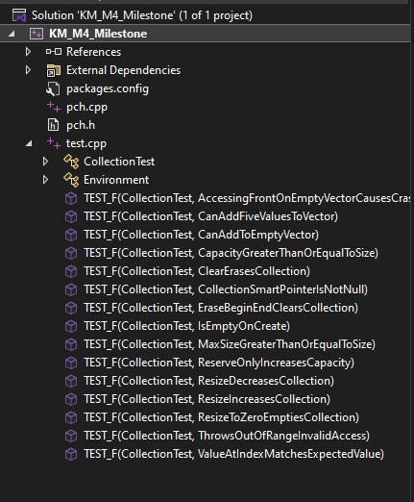
Unit Testing
Vulnerability chosen: Improper vector usage in C++ (memory safety & invalid address).
Framework: Google Test in Visual Studio
Tests included: 3 positive + 2 negative
Goal: Show how automated testing catches issues before release.

Slide 9
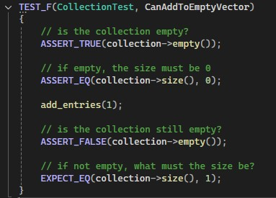
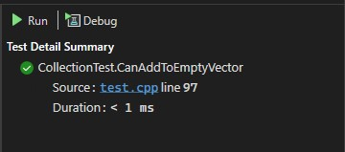
Test 1: Add to an Empty Vector
Test (Positive): Add one element to an empty vector.
Expected result: Vector size = 1.
Outcome: PASS

Slide 10
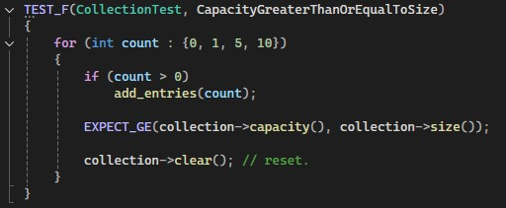
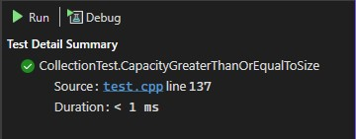
Test 2: Capacity >= Size
Test (Positive): Add entries, check size vs capacity.
Expected result: Capacity always >= size.
Outcome: PASS

Slide 11
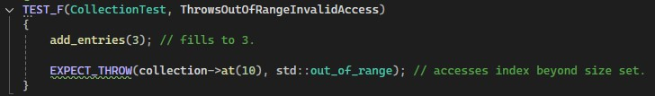
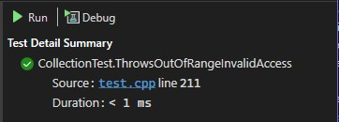
Test 3: Throws Out_of_Range on Invalid Access
Test (Negative): Access index 10 in vector of size 3.
Expected result: std::out_of_range exception.
Outcome: PASS

Slide 12
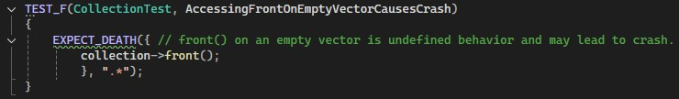
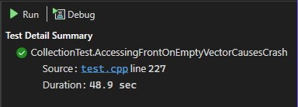
Test 4: Accessing Front on Empty Vector
Test (Negative): Call .front() on an empty vector.
Expected result: Crash – EXPECT_DEATH triggers.
Outcome: PASS

Slide 13
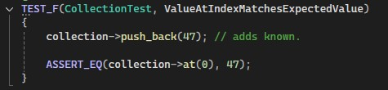
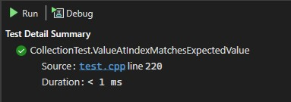
Test 5: Value at Index Matches Expected Value
Test (Positive): Insert value 47, retrieve index 0.
Expected result: Value at index equals 47.
Outcome: PASS

Slide 14

AUTOMATION SUMMARY

Slide 15
TOOLS
DevSecOps Pipeline
DevSecOps integrates security into every stage of the DevOps pipeline, from design through monitoring.
Instead of security checks happening at the end, they are baked in continuously through code analysis, dependency scanning, penetration tests, and automated monitoring.
This ensures vulnerabilities are caught early and often, reducing cost and risk.
External tools used at each stage
Design & Build: Static Application Security Testing (SAST) tools like SonarQube or Checkmarx to scan source code, and dependency checkers like OWASP Dependency-Check.
Verify & Test: Dynamic Application Security Testing (DAST) tools such as OWASP ZAP or Burp Suite for runtime testing.
Transition & Deployment: Container scanning tools like Anchore or Trivy, and Infrastructure as Code security tools like Terraform with Sentinel.
Monitor & Detect: SIEM platforms like Splunk or Elastic Security and intrusion detection like Snort.
Respond & Stabilizer: Automated rollback with Kubernetes, orchestration with Ansible, alerting through PagerDuty or Opsgenie.

Slide 16
RISKS AND BENEFITS
Problems
Manual testing slows releases and leaves gaps.
Security is often treated as an afterthought, increasing vulnerability exposure.
Lack of visibility across the pipeline means risks slip through unnoticed.
Solutions
Automating testing, scanning, and monitoring ensures continuous coverage.
Embedding security into DevOps shortens feedback loops.
Centralized tools give teams real-time insight into risks.
Risks if Delayed
Longer exposure to attacks (zero-day vulnerabilities).
Higher costs to fix issues late in development or post-production.
Reputational damage from breaches.
Benefits to Adoption
Faster delivery without sacrificing security.
Reduced long-term cost of remediation.
Builds customer trust through proactive defense.
Steps to Take
Start with small-scale automation like code-scanning and dependency checks.
Expand to DAST, container scans, and CI/CD integration.
Establish continuous monitoring and incident response automation.

Slide 17
RECOMMENDATIONS
Strengthen Policy Enforcement
Current policies exist but lack consistent enforcement. Recommend introduction to automated compliance checks.
Expand Testing Coverage
Manual testing leaves blind spots. Recommend integrating continuous automated unit, integration, and security tests.
Improve Monitoring & Logging
Logging is in place but limited in scope. Recommend expanding to cover anomaly detection and real-time alerts (SIEM).
Embed Security in Development
Shift security left in the DevOps cycle with static analysis (SAST) and dependency checks before deployment.
Regular Training & Awareness
Developers and ops teams need ongoing training on secure coding, vulnerability trends, and incident response.
Incident Response Plan Update
Current plan does not address modern threats. Recommend adding zero-day response strategies and periodic drills.

Slide 18
CONCLUSIONS
Adopt Secure Coding Standards
Use SEI CERT C++/C coding standards and OWASP best practices to reduce vulnerabilities.
Implement Compliance Frameworks
Align with ISO/IEC 27001 and NIST Cybersecurity Framework for governance and risk management.
Embed Continuous Security Testing
Apply SAST, DAST, and dependency scanning throughout the CI/CD pipeline.
Standardize Logging & Monitoring
Adopt SIEM integration with standardized event logging for faster detection and response.
Regular Policy Review
Update security standards annually to adapt to new threats and technologies.

Slide 19
REFERENCES
References
Dunham, R. (2020, May 5). Information Security Policies: Why They Are Important to Your Organization. Linford & Company LLP. https://linfordco.com/blog/information- security-policies/
Murray, A. (2020, June 13). Secure Coding: A Practical Guide. Mend. https://www.mend.io/blog/secure-coding/
OWASP. (2023). OWASP foundation, the open source foundation for application security. Owasp.org. https://owasp.org/
Schiela, R. (n.d.). SEI CERT Coding Standards - CERT Secure Coding - Confluence. Wiki.sei.cmu.edu. https://wiki.sei.cmu.edu/confluence/display/seccode/SEI+CERT+Coding+Standards
Seacord, R. C. (2013). Secure coding in C and C++. Editora: Upper Saddle River Addison-Wesley.

